Slide 1
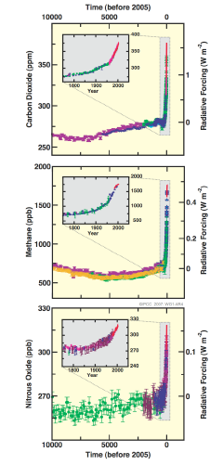

Slide 2
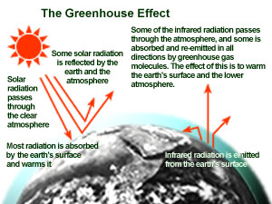

Slide 3
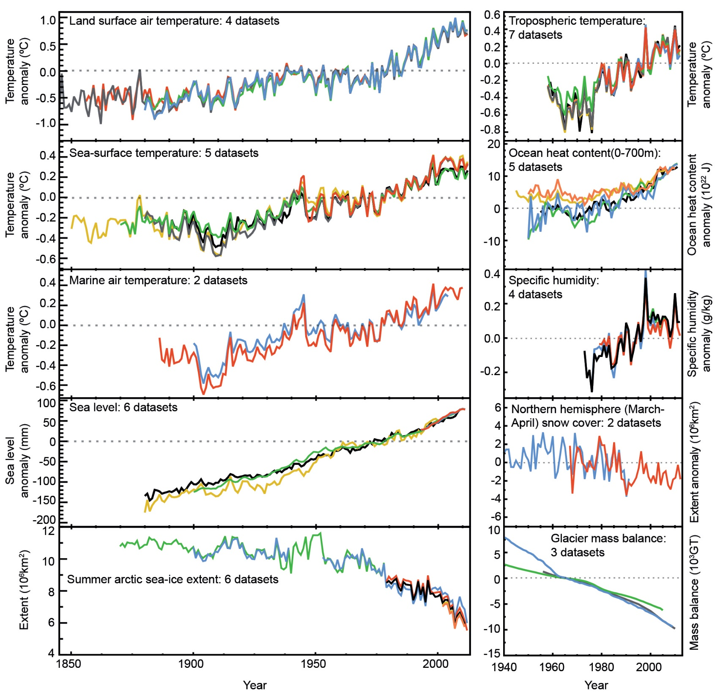

Slide 4
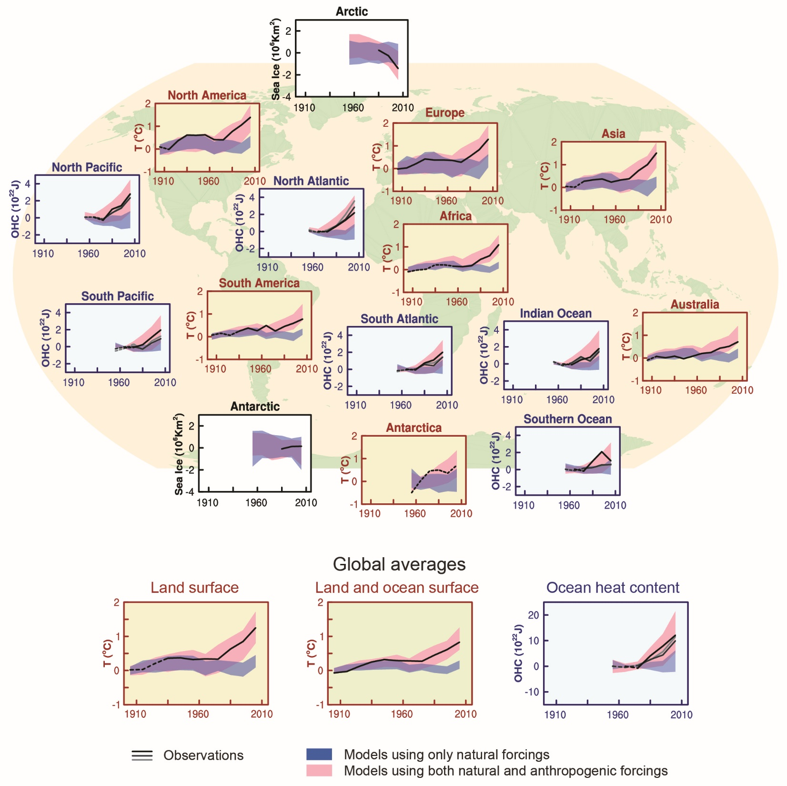

Slide 5
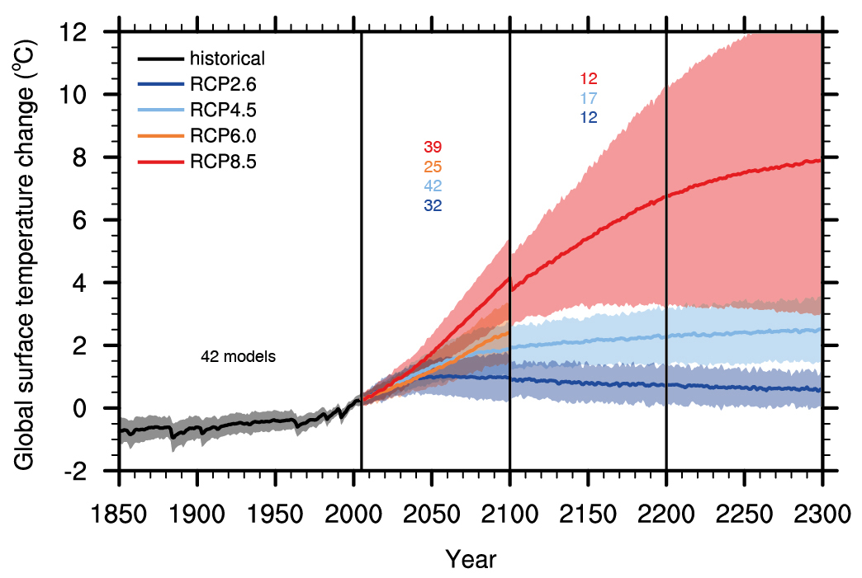

Slide 6
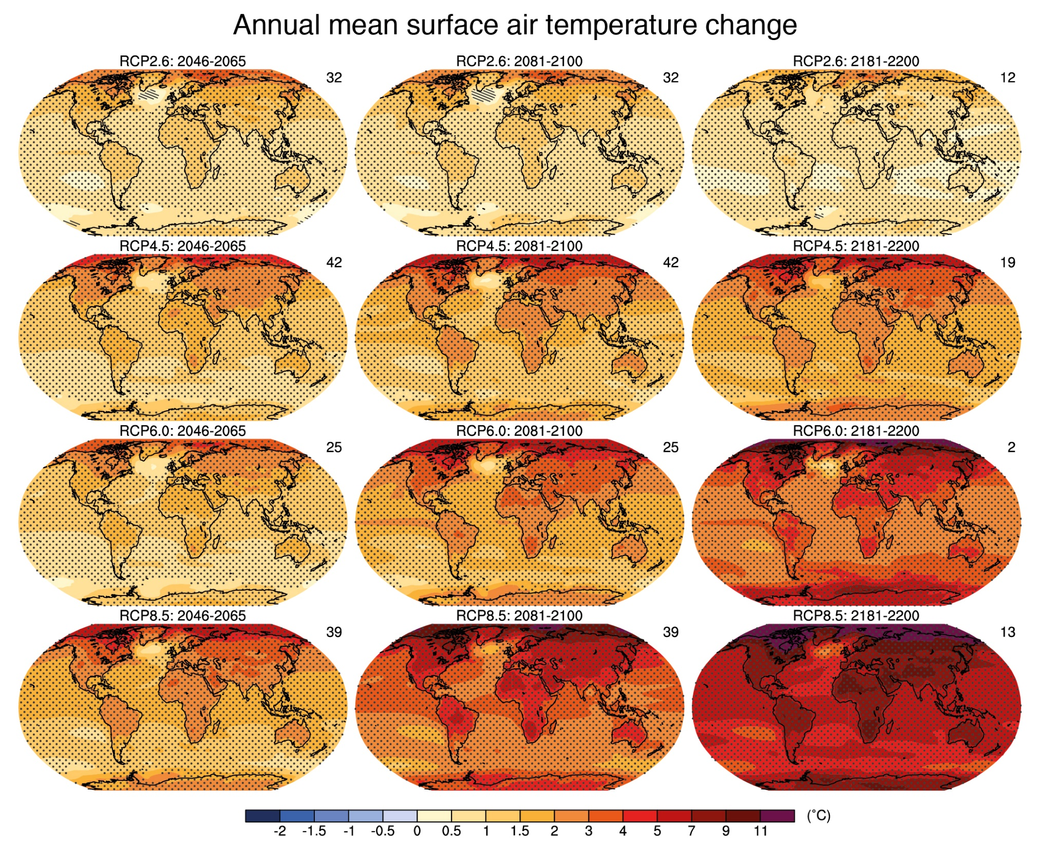

Slide 7
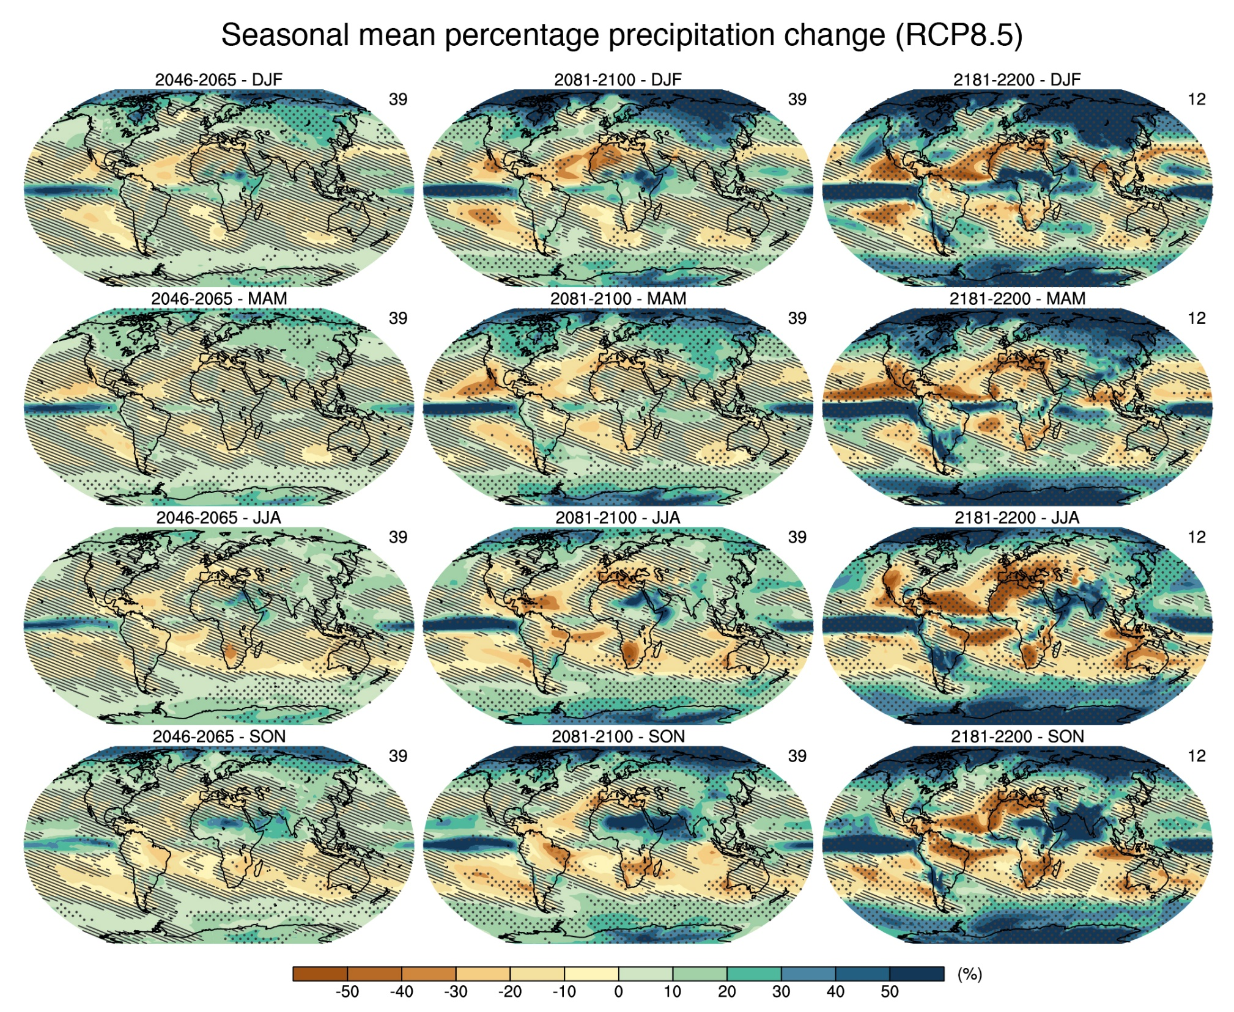

Slide 8
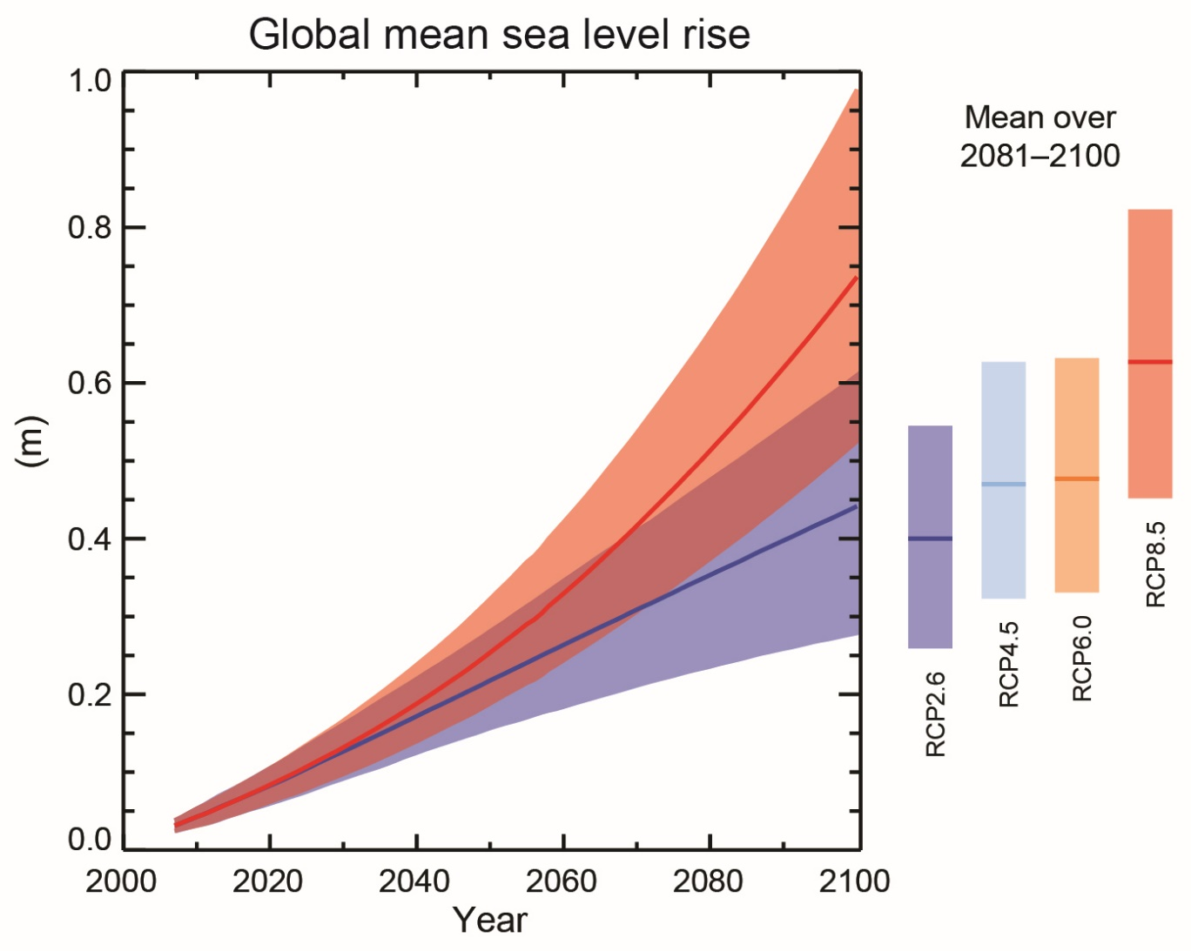
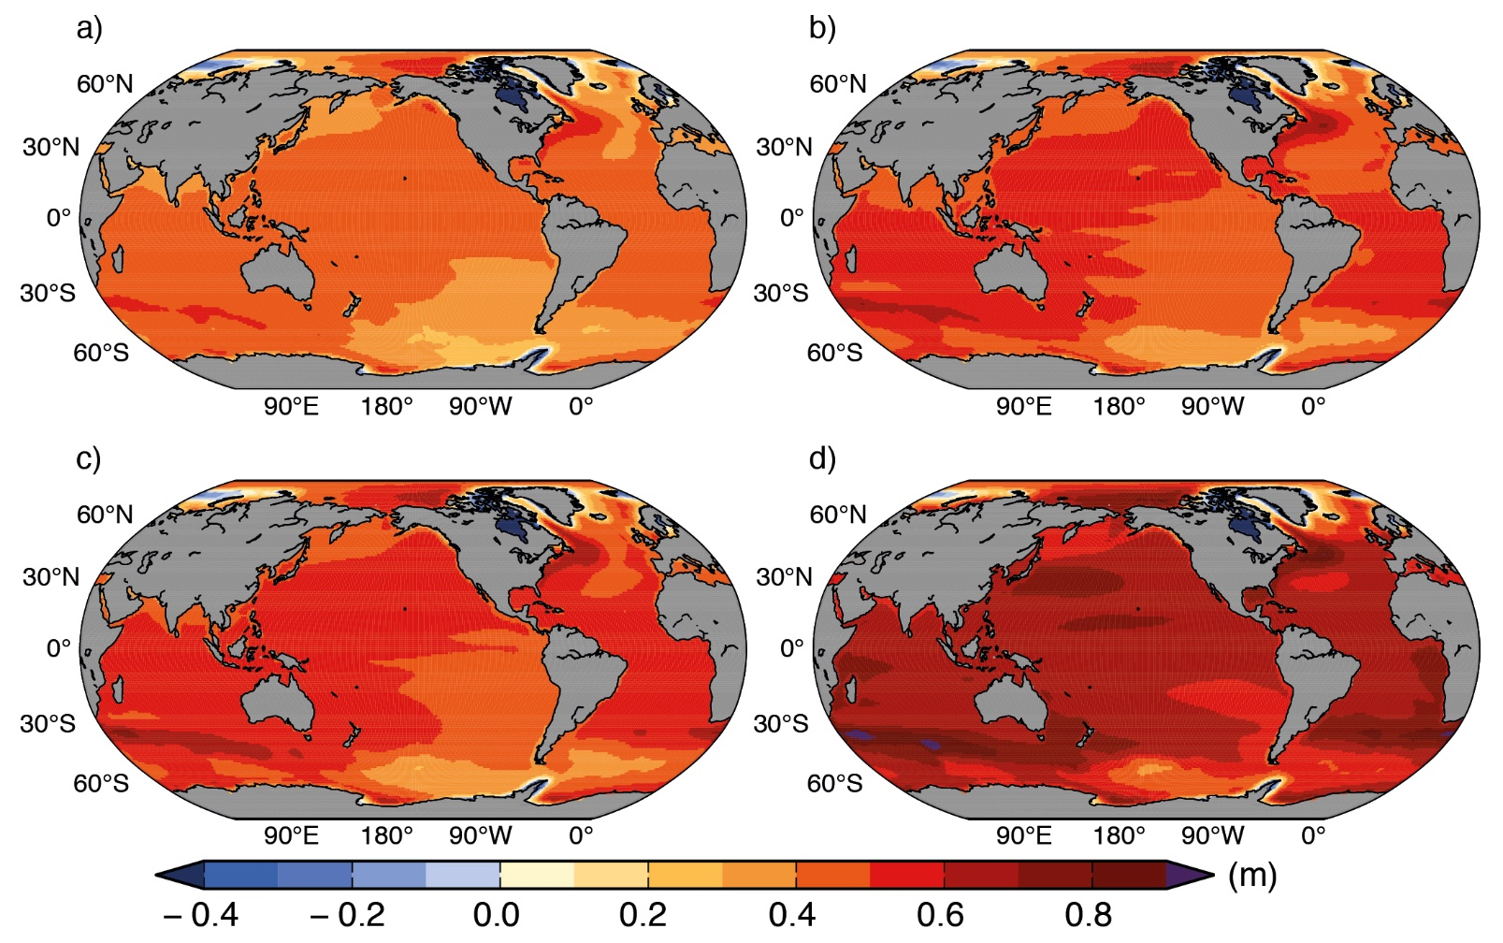
Water expands as it warms. A little bit. Ocean is on average 3 km deep. Tiny
expansion is large to humans.
Besides, ice melts.

Slide 9
Other effects
Storms
Extratropical storms: Probably more intense
Tropical storm: Probably no change in area or frequence, but probably more violent
Rainfall
Some places will get wetter, others drier
Some places will get wetter in winter and drier in summer
Ocean acidification
The proper name for (dissolved) CO2 is carbonic acid
As there is more CO2 in the atmosphere, there is more CO2 in the ocean
This increases the acidity of sea water
Bad for calciferous species

Slide 10
Emission Reduction
Emissions and emission reduction
Emission sources
Kaya Identity: Past and future
Options for emission reduction
Saving energy
Switching fuels
Carbon capture and storage
Geoengineering
Costs of emission reduction
Instruments for emission reduction

Slide 11
Climate Change Economics
Emission reduction
Scenarios
Costs
Instruments
Impacts of climate
Impacts and valuation
Total and marginal costs
Impacts and development
Climate policy
Optimal climate policy
Secondary benefits
Discounting, equity, uncertainty

Slide 12
Emission Reduction
Emissions and emission reduction
Emission sources
Kaya Identity: Past and future
Options for emission reduction
Saving energy
Switching fuels
Carbon capture and storage
Geoengineering
Costs of emission reduction
Instruments for emission reduction

Slide 13
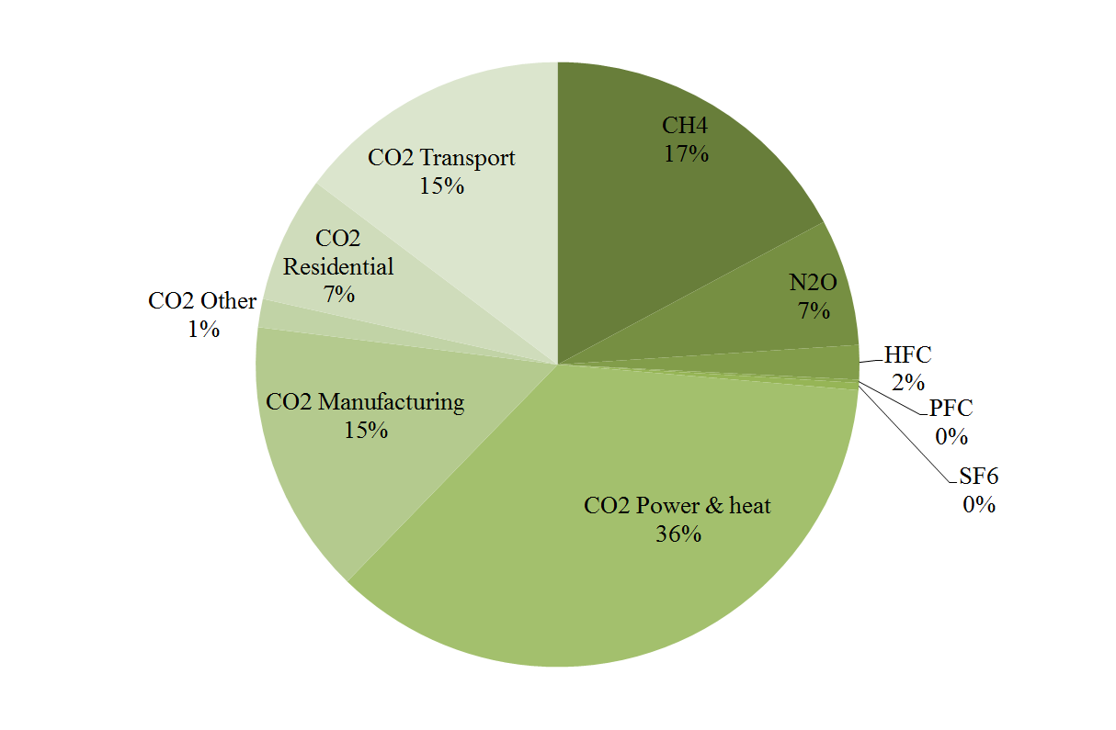
Sources of greenhouse gas emissions
Carbon dioxide
Combustion of fossil fuels
Land use change
Cement production
Methane
Ruminants
Paddy rice
Waste
Leakage
Nitrous oxide
Agriculture
Other gases
Specialised industry

Slide 14
Emission Reduction
Emissions and emission reduction
Emission sources
Kaya Identity: Past and future
Options for emission reduction
Saving energy
Switching fuels
Carbon capture and storage
Geoengineering
Costs of emission reduction
Instruments for emission reduction

Slide 15
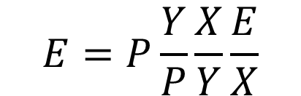
Emission trends
$$E=P\frac{Y}{P}\frac{X}{Y}\frac{E}{X}$$

Slide 17
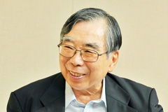
Emission scenarios
$$E=P\frac{Y}{P}\frac{X}{Y}\frac{E}{X}$$
Kaya identity
So, we need to predict how many people there will be in the future, how rich they will be, how much energy they will use, and what sort of energy; how much waste they will generate and how they will dispose of it; and what they will eat and where that food will be grown
And over a period of 100 years or more
Scenario uncertainty is compounded by uncertainty over climate and carbon cycle

Slide 18
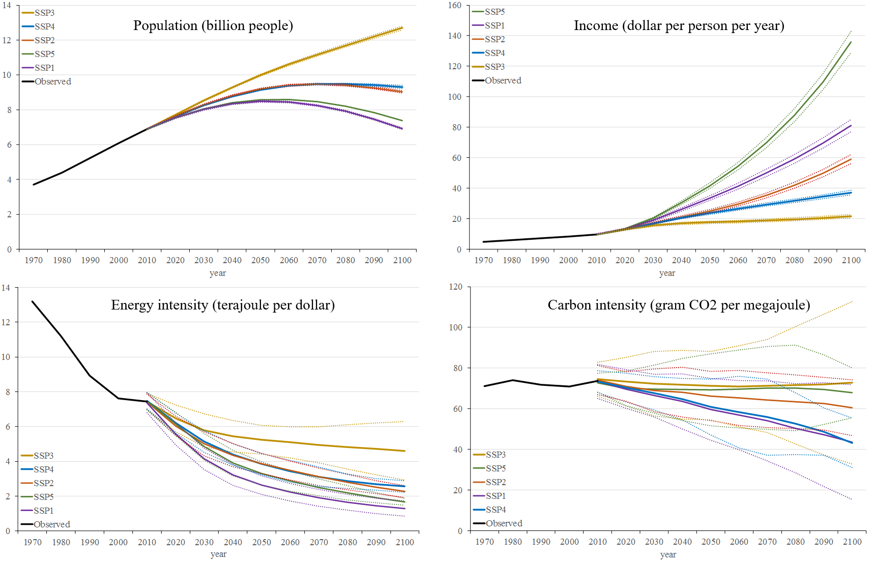

Slide 19
Emission Reduction
Emissions and emission reduction
Emission sources
Kaya Identity: Past and future
Options for emission reduction
Saving energy
Switching fuels
Carbon capture and storage
Geoengineering
Costs of emission reduction
Instruments for emission reduction

Slide 20

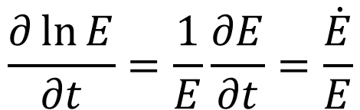
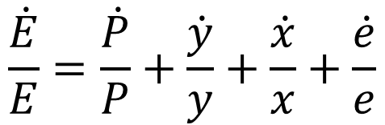
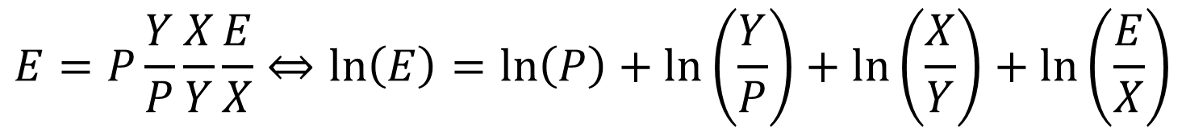
How to abate emissions?
Kaya identity
To reduce emissions, one can
Reduce population growth
Reduce economic growth
Save energy
Switch to different energy sources
$$E=P\frac{Y}{P}\frac{X}{Y}\frac{E}{X}⇔\ln\left(E\right)=\ln\left(P\right)+\ln\left(\frac{Y}{P}\right)+\ln\left(\frac{X}{Y}\right)+\ln\left(\frac{E}{X}\right)$$
$$\frac{∂\ln{E}}{∂t}=\frac{1}{E}\frac{∂E}{∂t}=\frac{\dot{E}}{E}$$
$$\frac{\dot{E}}{E}=\frac{\dot{P}}{P}+\frac{\dot{y}}{y}+\frac{\dot{x}}{x}+\frac{\dot{e}}{e}$$

Slide 21
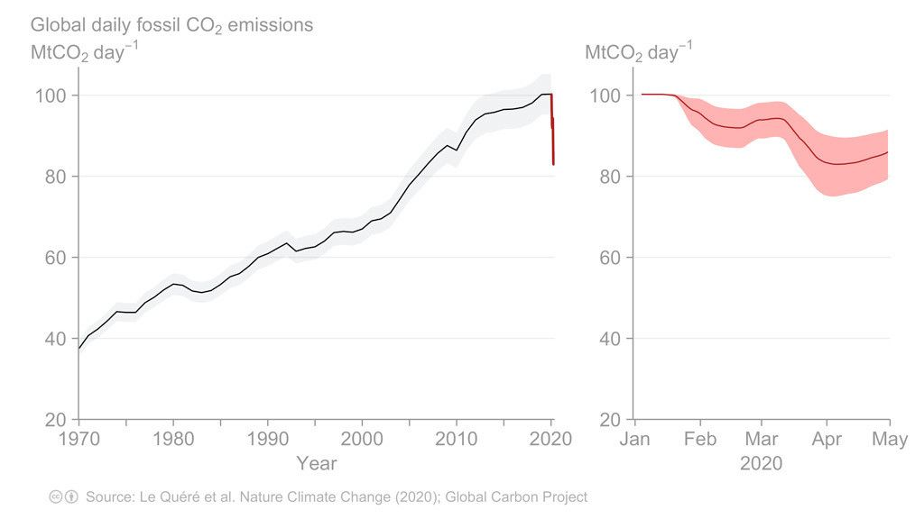
CO2 emissions during a pandemic

Slide 22
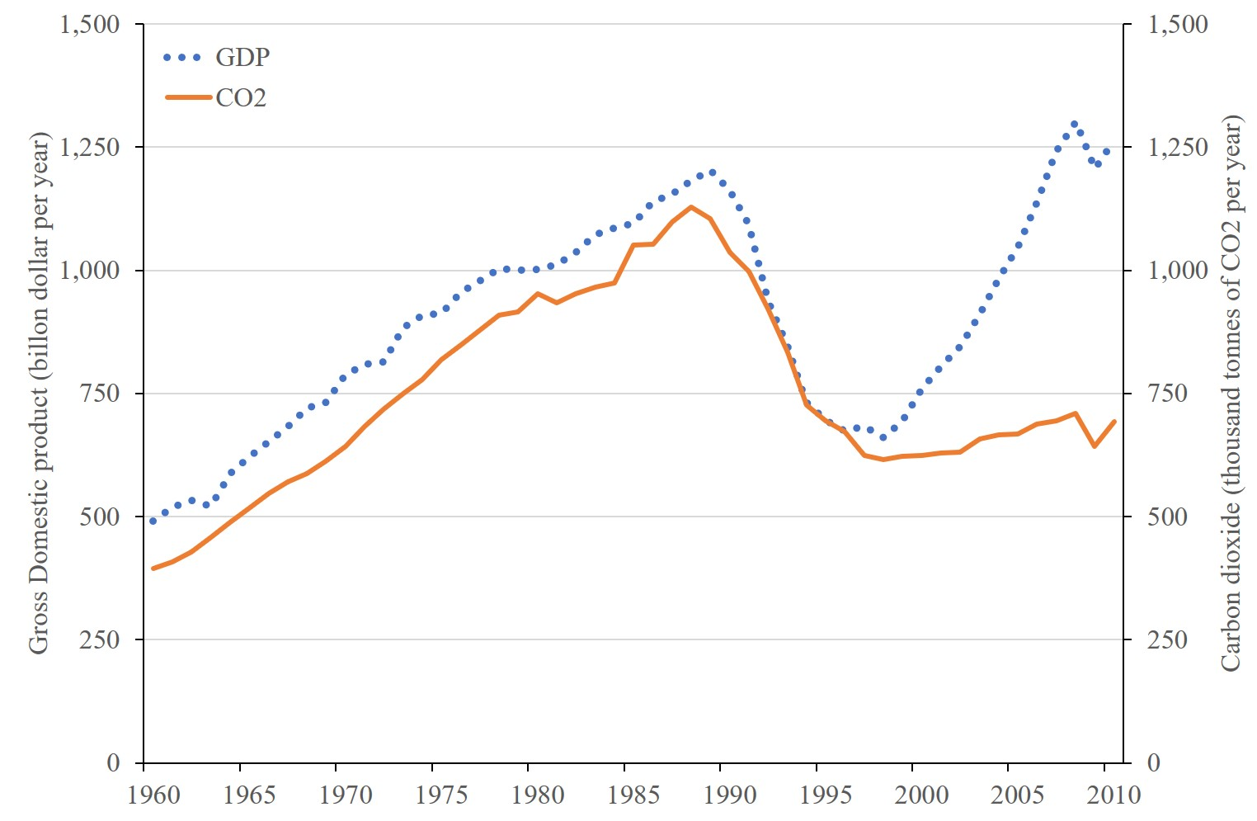
Former USSR: Economy and emissions

Slide 23
Emission Reduction
Emissions and emission reduction
Emission sources
Kaya Identity: Past and future
Options for emission reduction
Saving energy
Switching fuels
Carbon capture and storage
Geoengineering
Costs of emission reduction
Instruments for emission reduction

Slide 24
How to abate emissions?
Kaya identity
To reduce emissions, one can
Reduce population growth
Reduce economic growth
Save energy
Switch to different energy sources
$$E=P\frac{Y}{P}\frac{X}{Y}\frac{E}{X}⇔\ln\left(E\right)=\ln\left(P\right)+\ln\left(\frac{Y}{P}\right)+\ln\left(\frac{X}{Y}\right)+\ln\left(\frac{E}{X}\right)$$
$$\frac{∂\ln{E}}{∂t}=\frac{1}{E}\frac{∂E}{∂t}=\frac{\dot{E}}{E}$$
$$\frac{\dot{E}}{E}=\frac{\dot{P}}{P}+\frac{\dot{y}}{y}+\frac{\dot{x}}{x}+\frac{\dot{e}}{e}$$

Slide 25
Save Energy
Energy savings come through technological change and behavioural change
For a single product, new models tend to be more efficient, but the technological advance may be used to increase comfort
A lot of energy is wasted
Habits are hard, maybe costly to change
Principal/agent problems
The demand for energy services is even harder to change

Slide 28
Save Energy
Energy savings come through technological change and behavioural change
For a single product, new models tend to be more efficient, but the technological advance may be used to increase comfort
A lot of energy is wasted
Habits are hard, maybe costly to change
Principal/agent problems
The demand for energy services is even harder to change

Slide 29
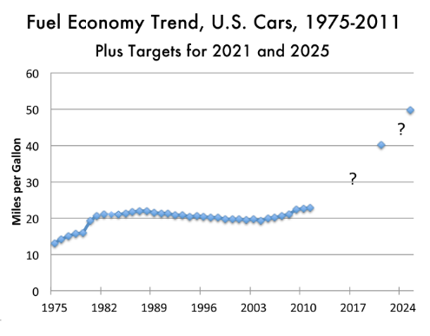
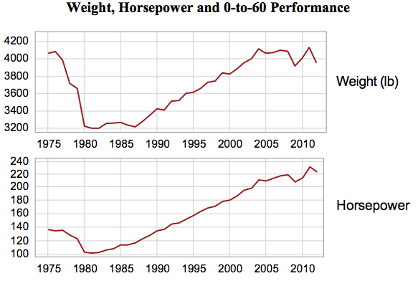

Slide 30
Save Energy
Energy savings come through technological change and behavioural change
For a single product, new models tend to be more efficient, but the technological advance may be used to increase comfort
A lot of energy is wasted
Habits are hard, maybe costly to change
Principal/agent problems
The demand for energy services is even harder to change

Slide 31
Save Energy
Energy savings come through technological change and behavioural change
For a single product, new models tend to be more efficient, but the technological advance may be used to increase comfort
A lot of energy is wasted
Habits are hard, maybe costly to change
Principal/agent problems
The demand for energy services is even harder to change

Slide 32
Emission Reduction
Emissions and emission reduction
Emission sources
Kaya Identity: Past and future
Options for emission reduction
Saving energy
Switching fuels
Carbon capture and storage
Geoengineering
Costs of emission reduction
Instruments for emission reduction

Slide 33
How to abate emissions?
Kaya identity
To reduce emissions, one can
Reduce population growth
Reduce economic growth
Save energy
Switch to different energy sources
$$E=P\frac{Y}{P}\frac{X}{Y}\frac{E}{X}⇔\ln\left(E\right)=\ln\left(P\right)+\ln\left(\frac{Y}{P}\right)+\ln\left(\frac{X}{Y}\right)+\ln\left(\frac{E}{X}\right)$$
$$\frac{∂\ln{E}}{∂t}=\frac{1}{E}\frac{∂E}{∂t}=\frac{\dot{E}}{E}$$
$$\frac{\dot{E}}{E}=\frac{\dot{P}}{P}+\frac{\dot{y}}{y}+\frac{\dot{x}}{x}+\frac{\dot{e}}{e}$$

Slide 34
Switch Energy
Switching away from oil, gas and coal to nuclear, hydro, wind, solar and biomass is technically feasible
Nuclear and hydro are difficult politically and socially
Wind and solar are no longer expensive
Wind is visually intrusive
Solar has a waste problem
Both wind and solar require storage and transport
Biomass is still too expensive, and bad for health, environment and food production

Slide 35
Sources of greenhouse gas emissions
Carbon dioxide
Combustion of fossil fuels
Peat 117, Coal 95, Petrol 70, Gas 57 tCO2/TJ
Land use change
Cement production
Methane
Ruminants
Paddy rice
Waste
Leakage
Nitrous oxide
Agriculture
Other gases
Specialised industry

Slide 36
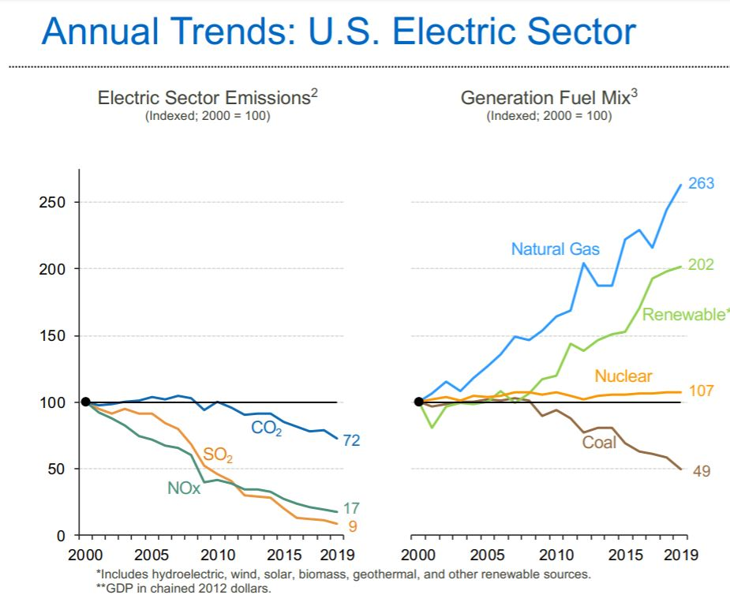

Slide 37
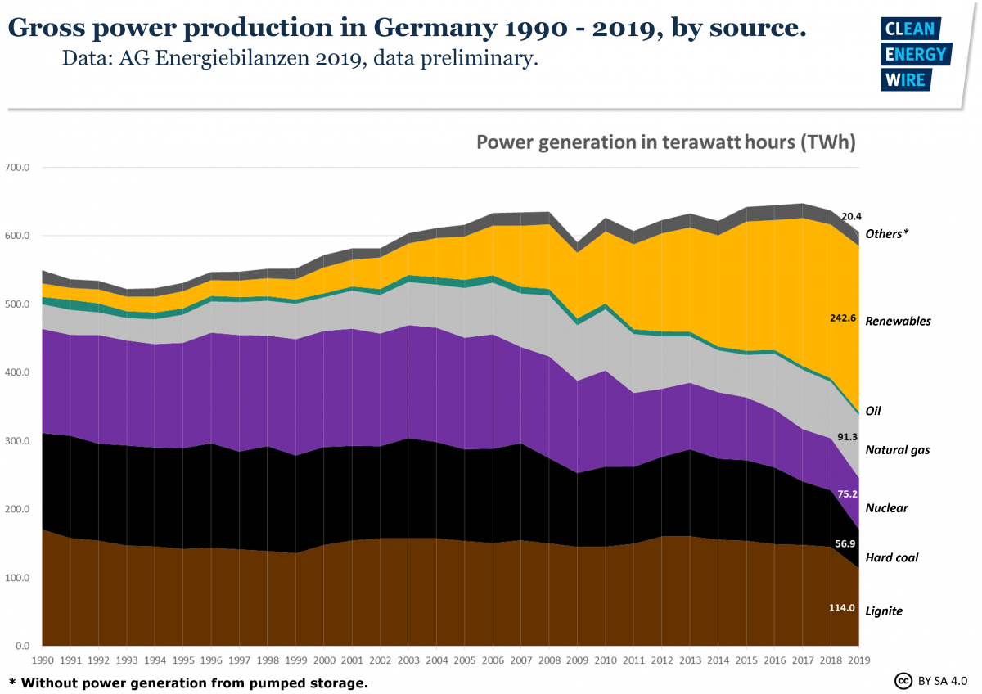

Slide 38
Switch Energy
Switching away from oil, gas and coal to nuclear, hydro, wind, solar and biomass is technically feasible
Nuclear and hydro are difficult politically and socially
Wind and solar are no longer expensive
Wind is visually intrusive
Solar has a waste problem
Both wind and solar require storage and transport
Biomass is too expensive, and bad for health, environment and food production

Slide 40
Switch Energy
Switching away from oil, gas and coal to nuclear, hydro, wind, solar and biomass is technically feasible
Nuclear and hydro are difficult politically and socially
Wind and solar are no longer expensive
Wind is visually intrusive
Solar has a waste problem
Both wind and solar require storage and transport
Biomass is still too expensive, and bad for health, environment and food production

Slide 41
Switch Energy
Switching away from oil, gas and coal to nuclear, hydro, wind, solar and biomass is technically feasible
Nuclear and hydro are difficult politically and socially
Wind and solar are no longer expensive
Wind is visually intrusive
Solar has a waste problem
Both wind and solar require storage and transport
Biomass is still too expensive, and bad for health, environment and food production

Slide 42
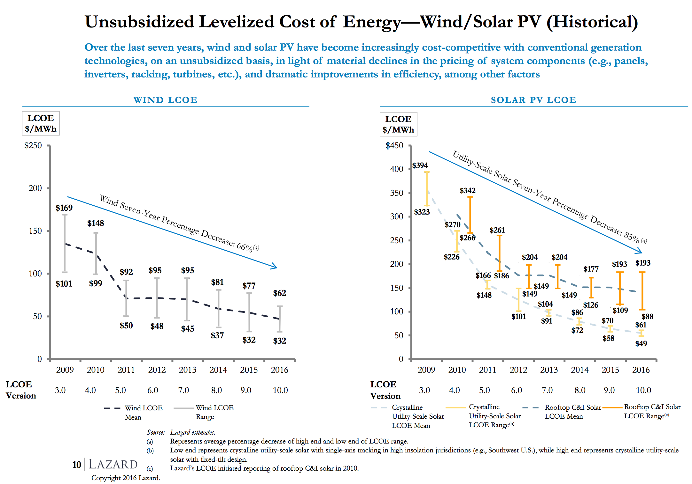

Slide 43
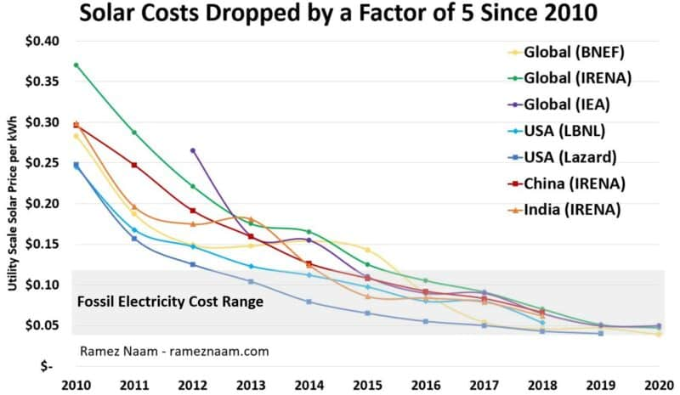

Slide 44
Switch Energy
Switching away from oil, gas and coal to nuclear, hydro, wind, solar and biomass is technically feasible
Nuclear and hydro are difficult politically and socially
Wind and solar are no longer expensive
Wind is visually intrusive
Solar has a waste problem
Both wind and solar require storage and transport
Biomass is still too expensive, and bad for health, environment and food production

Slide 45
Switch Energy
Switching away from oil, gas and coal to nuclear, hydro, wind, solar and biomass is technically feasible
Nuclear and hydro are difficult politically and socially
Wind is expensive and visually intrusive
Solar is expensive and has a waste problem
Both wind and solar require storage and transport
First generation biomass is too expensive, and bad for health, environment and food production

Slide 46
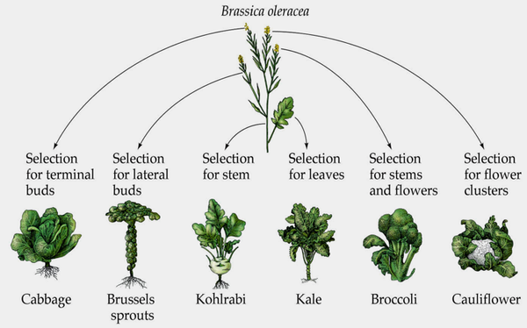

Slide 47
Switch Energy
Switching away from oil, gas and coal to nuclear, hydro, wind, solar and biomass is technically feasible
Nuclear and hydro are difficult politically and socially
Wind is expensive and visually intrusive
Solar is expensive and has a waste problem
Both wind and solar require storage and transport
Biomass is still too expensive, and bad for health, environment and food production

Slide 48
Emission Reduction
Emissions and emission reduction
Emission sources
Kaya Identity: Past and future
Options for emission reduction
Saving energy
Switching fuels
Carbon sinks
Carbon capture and storage
Geoengineering
Costs of emission reduction
Instruments for emission reduction

Slide 49
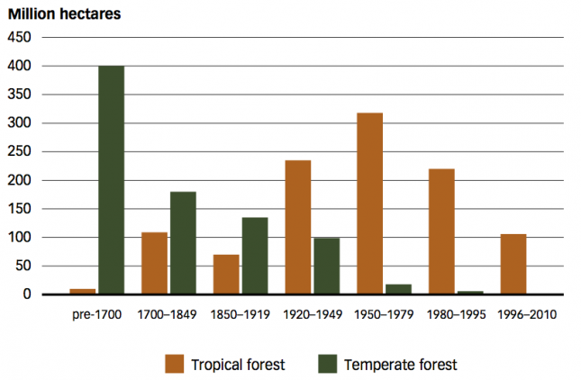
Carbon Sinks
Deforestation is a source of CO2 emissions, afforestation a sink
Forests of North America and Europe are growing back
If slowing deforestation in the tropics were easy, it would have been done for other reasons

Slide 50
Carbon Capture and Storage
Take the CO2 out of the exhaust gas, and stick it in the ground
Proven technology: soda, beer, greenhouses, and enhanced oil recovery
However, abatement requires purpose-build storage at a much larger scale
Retrofit expensive, so for new power stations only
Issues with cost, permanence, safety
End-of-pipe technology
If used for biomass, negative emissions

Slide 51
Geoengineering
Change the climate again
Mirrors in space
Dust in the atmosphere
Great uncertainty
Previous experiments went wrong (quite so)
Nonetheless, most of this is cheap and simple
Unclear who will/should decide on geoengineering

Slide 52
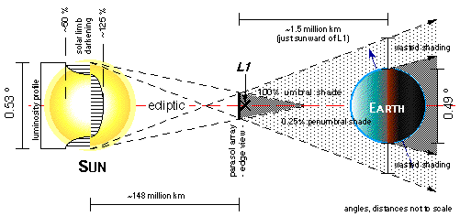

Slide 53
Geoengineering
Change the climate again
Mirrors in space
Dust in the atmosphere
Great uncertainty
Previous experiments went wrong (quite so)
Nonetheless, most of this is cheap and simple
Unclear who will/should decide on geoengineering

Slide 54
Geoengineering
Change the climate again
Mirrors in space
Dust in the atmosphere
Great uncertainty
Previous experiments went wrong (quite so)
Nonetheless, most of this is cheap and simple
Unclear who will/should decide on geoengineering

